Slide 1
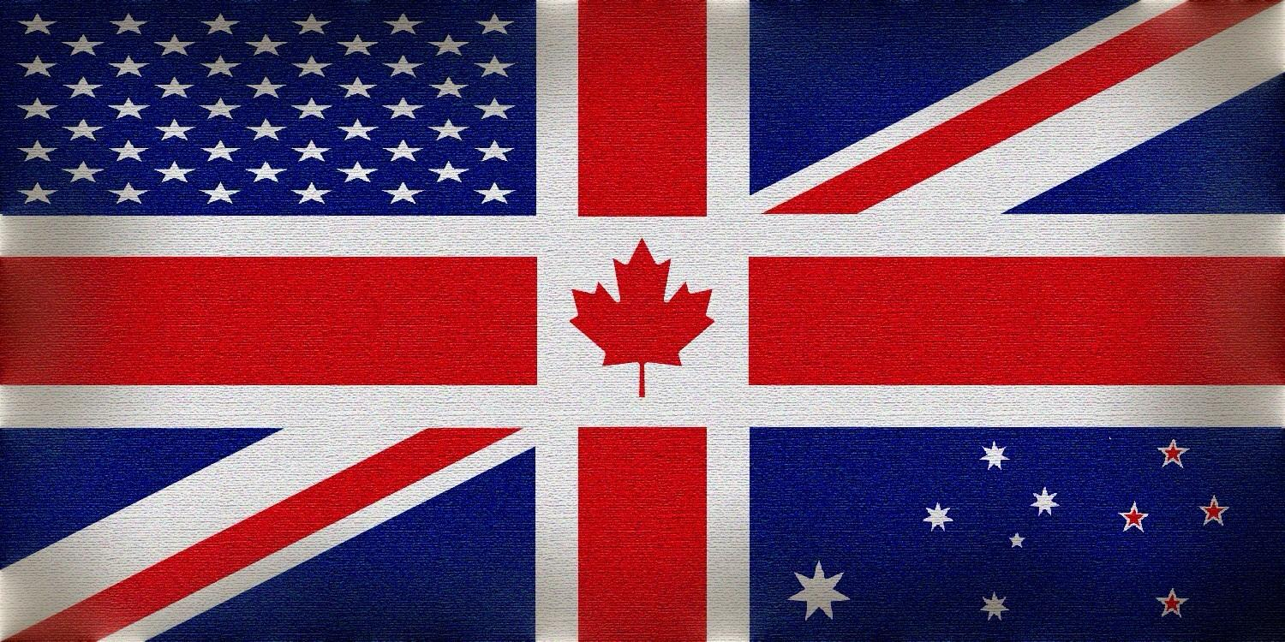

English-speaking
countries

Slide 2
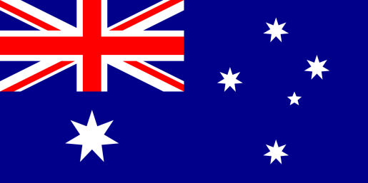
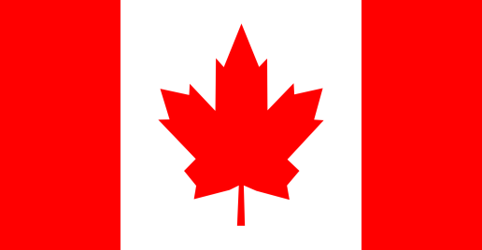
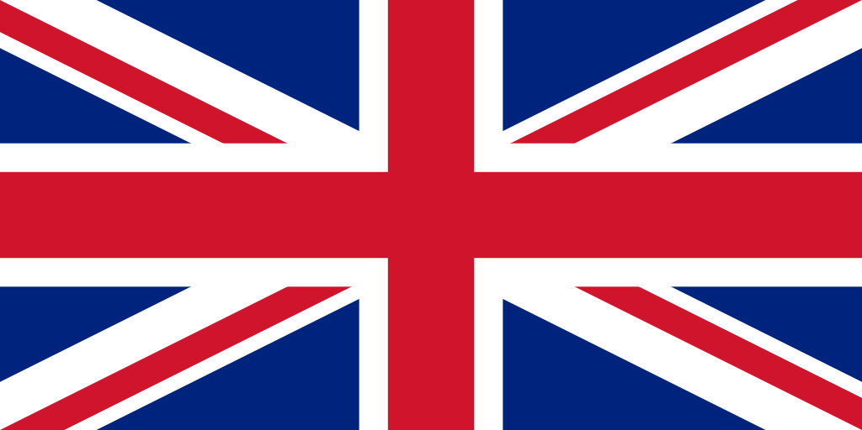
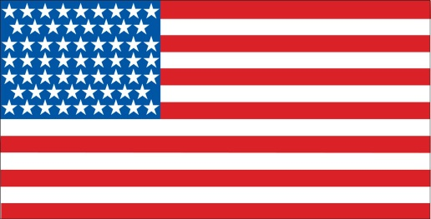
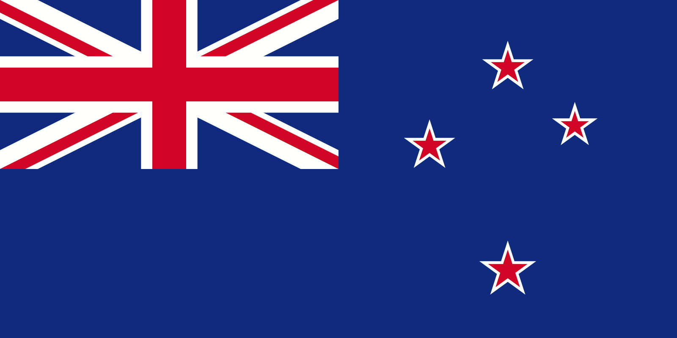
Match the countries with their flags
Canada
The USA
Australia
The UK
New Zealand
A.
B.
C.
D.
E.

Slide 3
Let’s check!
Canada
The USA
Australia
The UK
New Zealand
B.
D.
A.
C.
E.

Slide 4
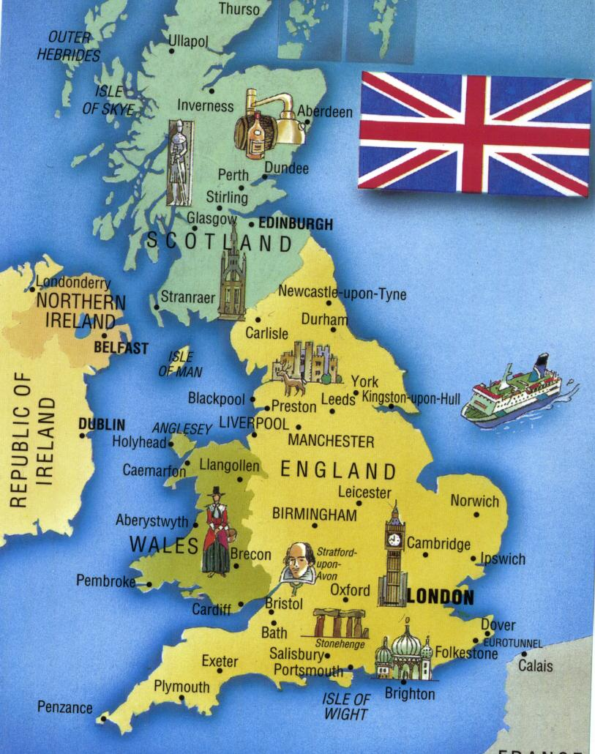
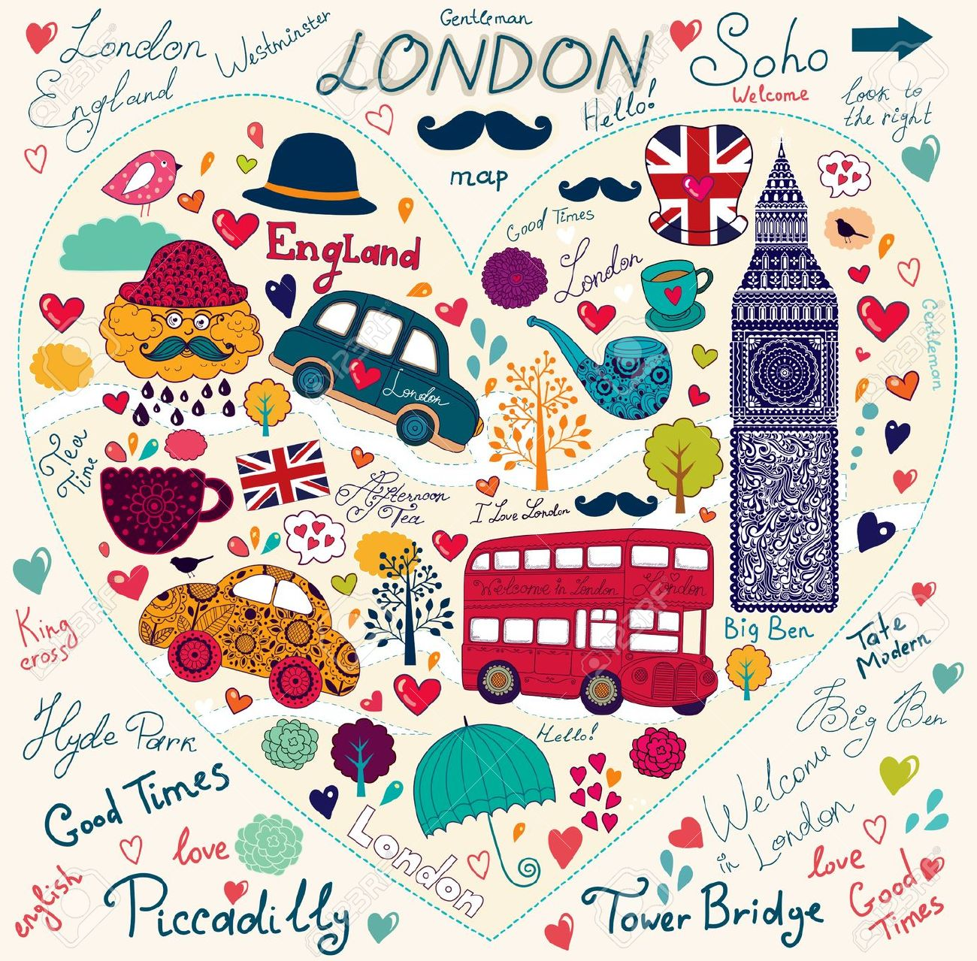
The United Kingdom of Great Britain and Northern Ireland

Slide 5
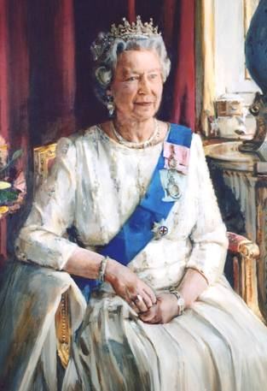
Who is the official Head of Great Britain?
The Queen
The King
C. The President

Slide 6
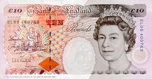
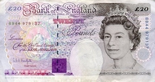
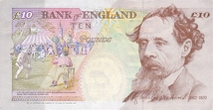
What is the monetary unit of Britain?
A. British dollar
B. pound sterling
C. euro

Slide 7
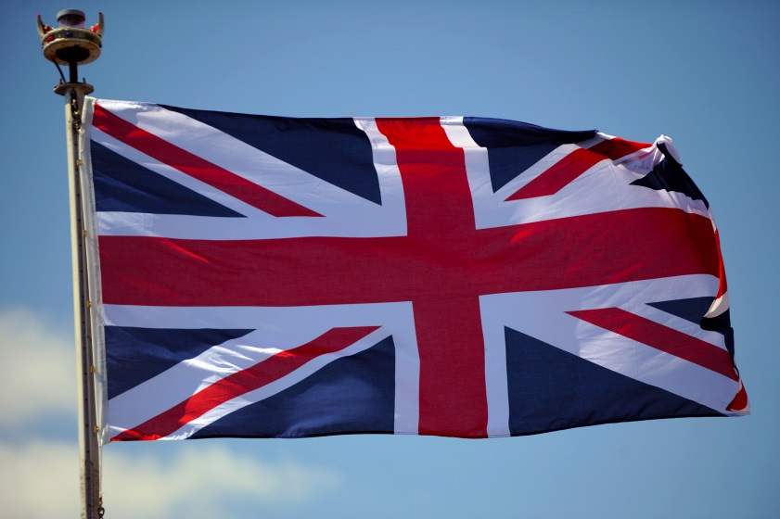
What is it “the Union Jack”?
the traditional English song
the flag of the USA
C. the flag of the United Kingdom

Slide 8
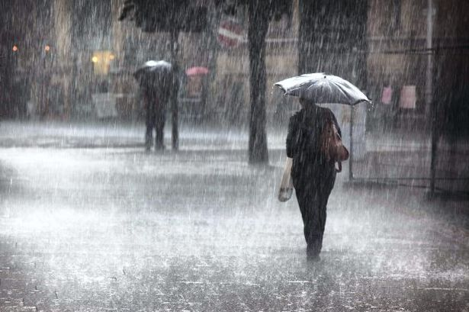
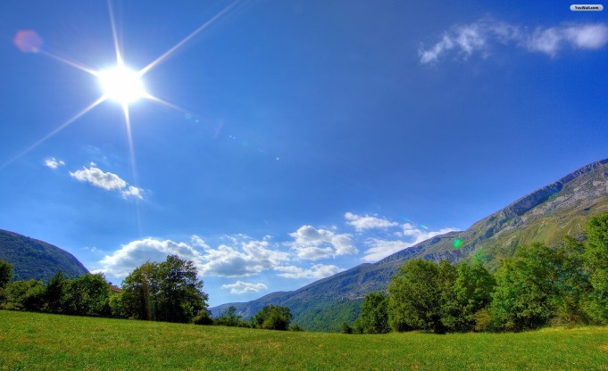
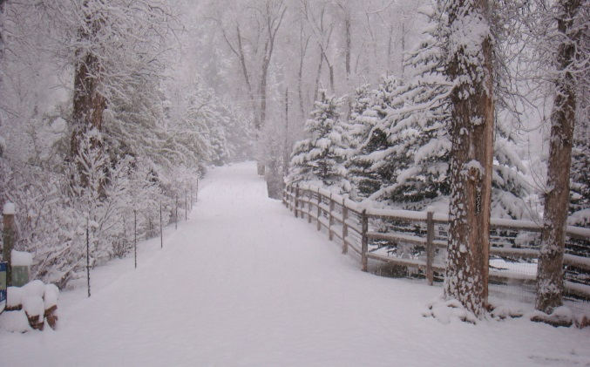
What weather is very usual in Great Britain?
A. rainy
B. sunny
C. snowy

Slide 9
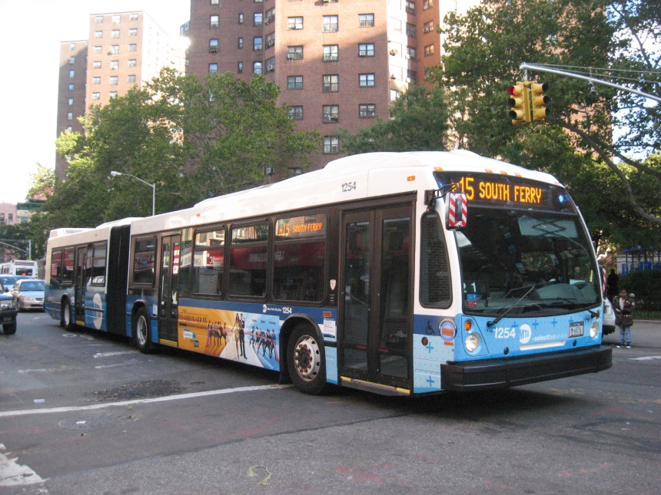
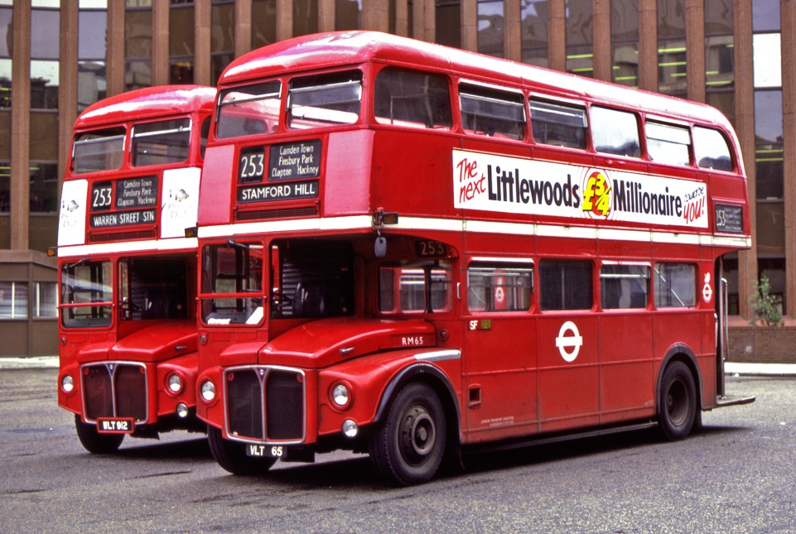
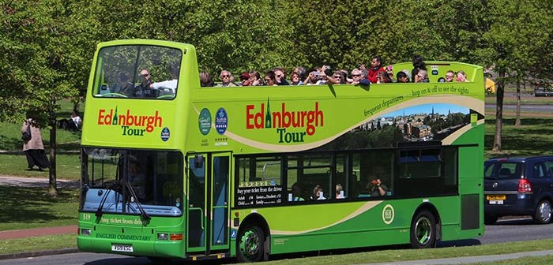
Choose the London bus
A.
B.
C.

Slide 10
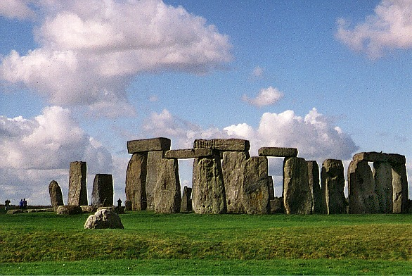
What is the oldest British monument?
Stonehenge
The Tower of London
C. Big Ben

Slide 11
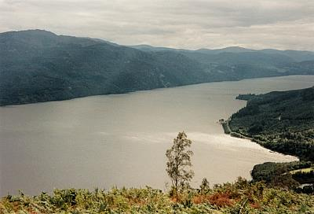
Where is the famous lake Loch Ness situated?
In Wales
In Scotland
In England

Slide 12
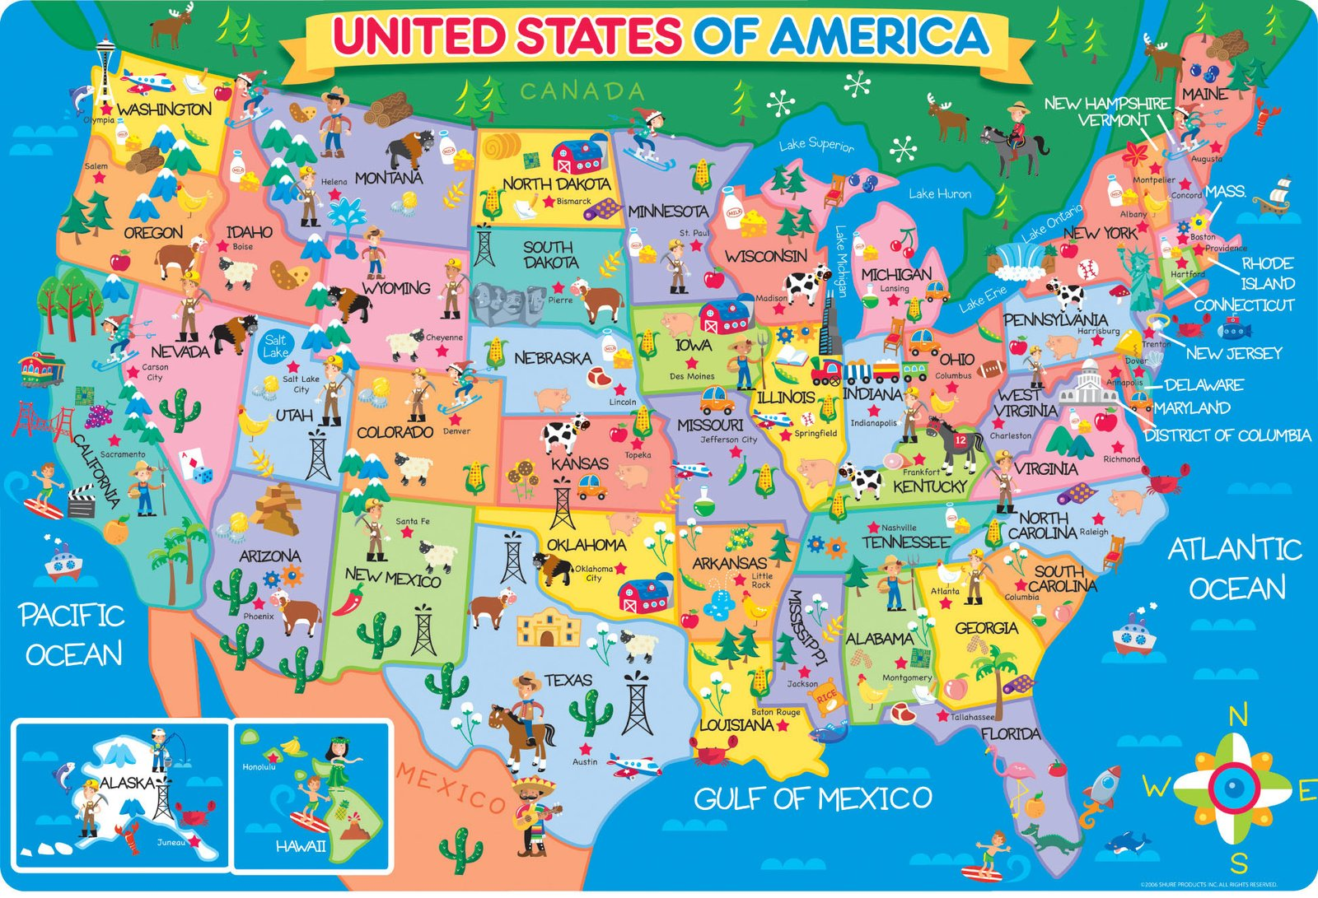
The United States of America

Slide 13
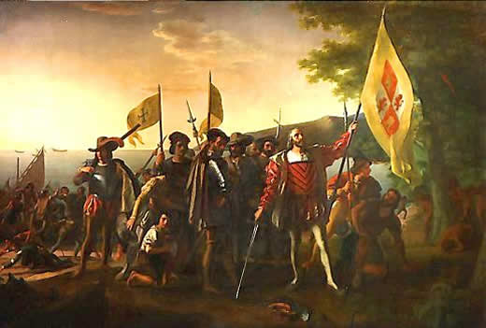
When did Christopher Columbus discover America?
In 1492
In 1429
C. In 1592

Slide 14
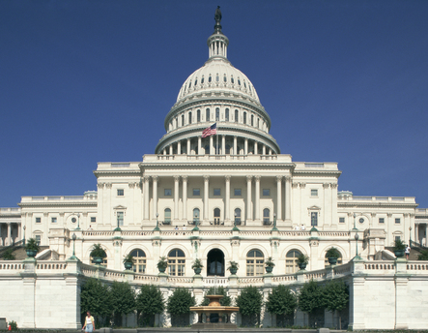
What is the capital of the USA?
Las Vegas
Washington DC
C. New York

Slide 15
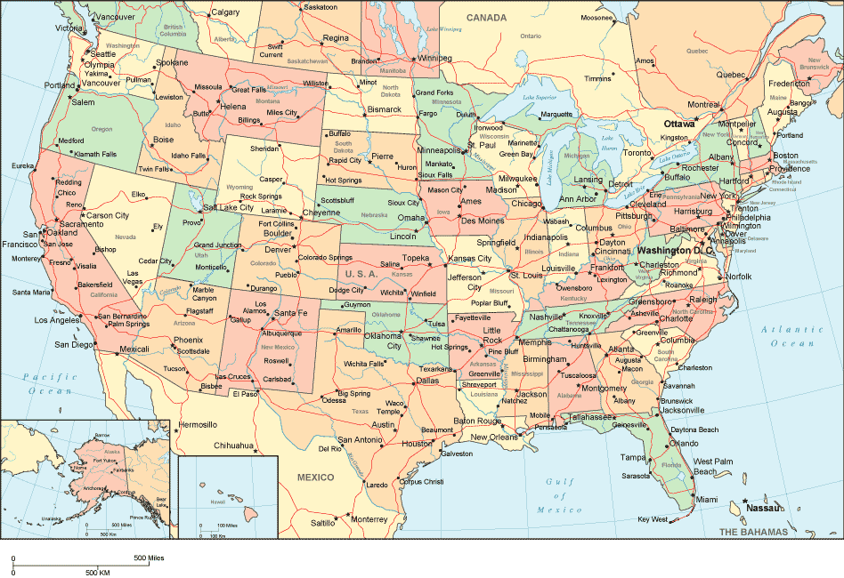
How many states are there in the USA?
38
50
C. 44

Slide 16
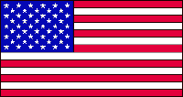
How many stars and stripes are there on the flag of the USA?
A. 50 stars, 13 stripes
B. 52 stars, 30 stripes
C. 48 stars, 15 stripes

Slide 17
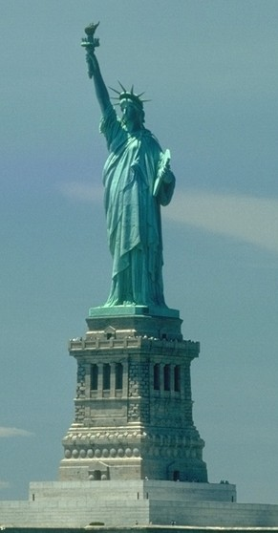
Where is the Statue of Liberty situated?
A. In New York
In San Francisco
C. In Los Angeles

Slide 18
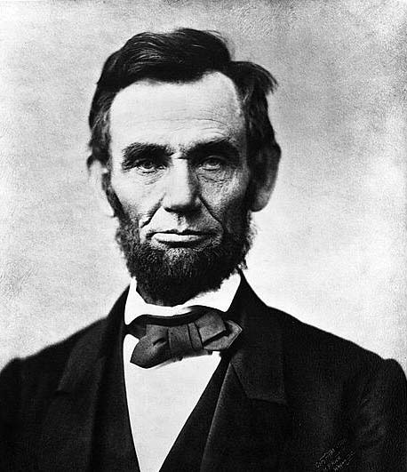
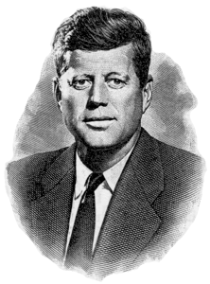
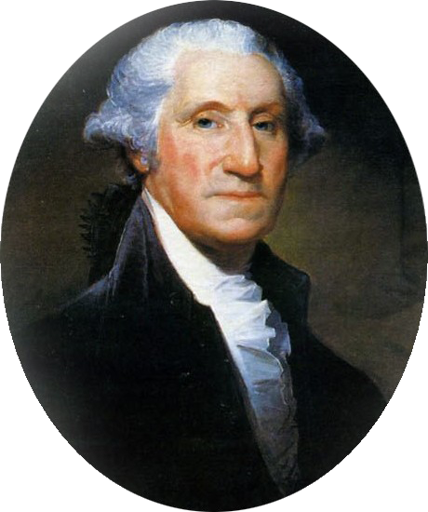
Who was the 1st president of the USA?
A.
George
Washington
B.
Abraham Lincoln
C.
John Kennedy

Slide 19
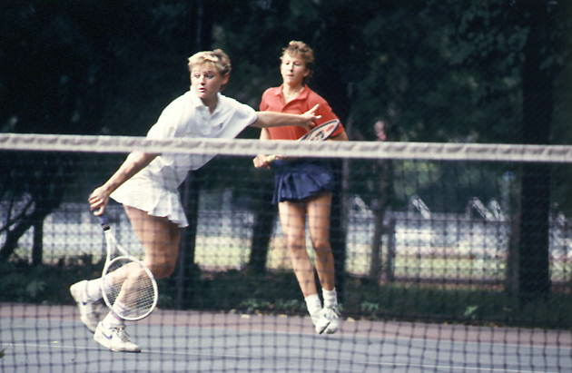
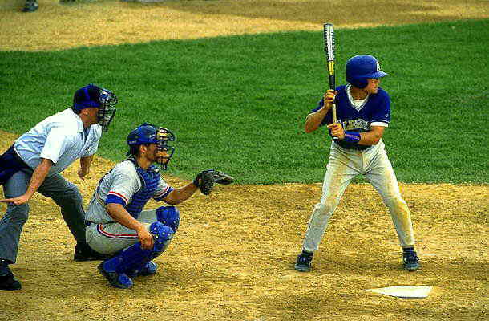
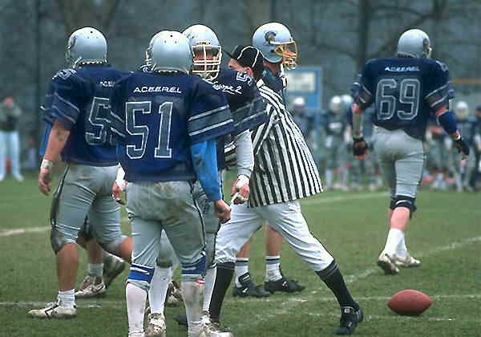
What kind of sport is the most popular in the USA?
A. tennis
B. baseball
C. American football

Slide 20
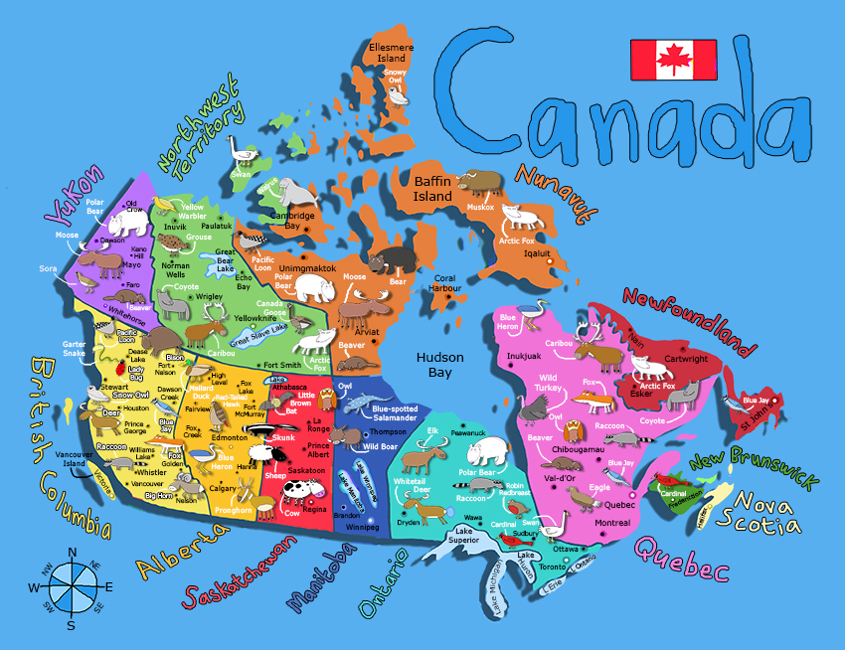
Canada

Slide 21

What is the capital of Canada?
Ottawa
Sydney
Toronto

Slide 22
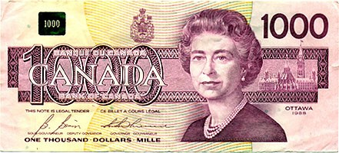
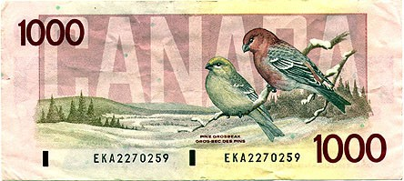
What is the monetary unit of Canada?
A. Canadian dollar
Canadian shilling
C. Canadian pound

Slide 23
Canada has 2 official languages:
A. English and Spanish
B. English and French
C. English and Irish

Slide 24
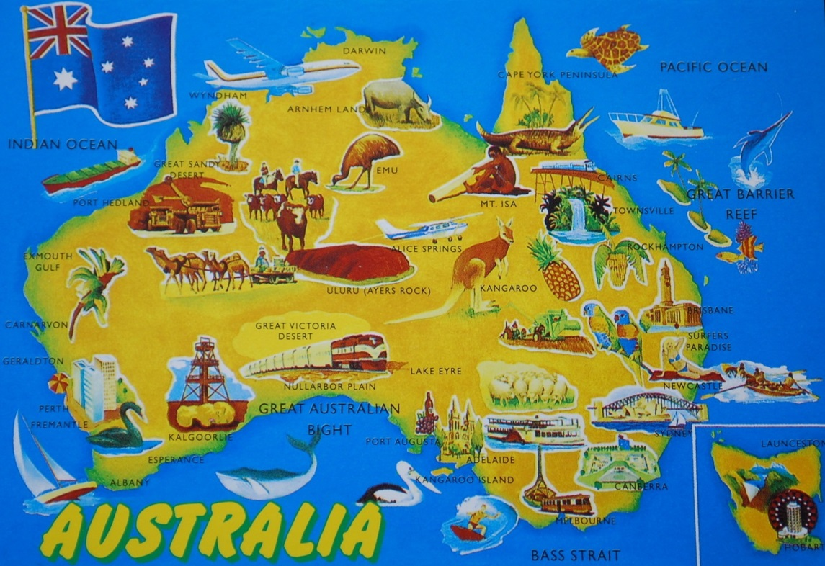
Australia

Slide 25
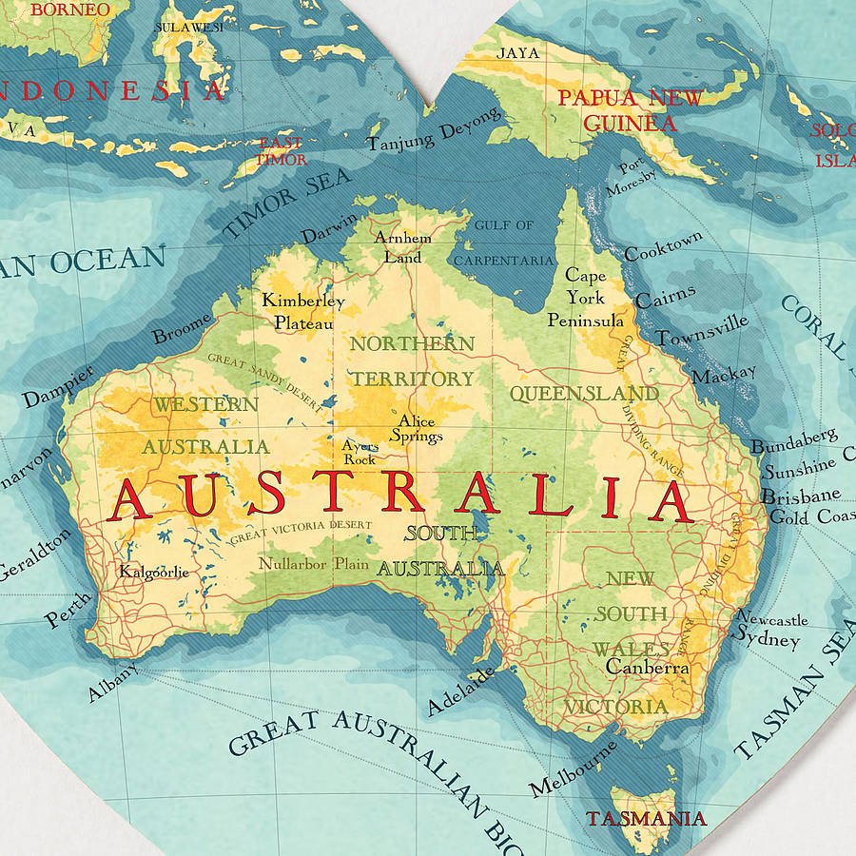
What is the capital of Australia?
Canberra
Sydney
C. Melbourne

Slide 26
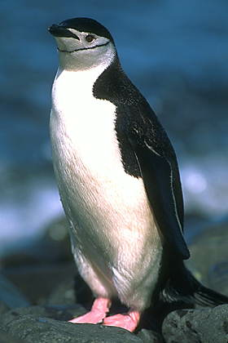
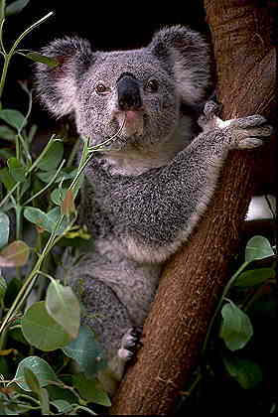
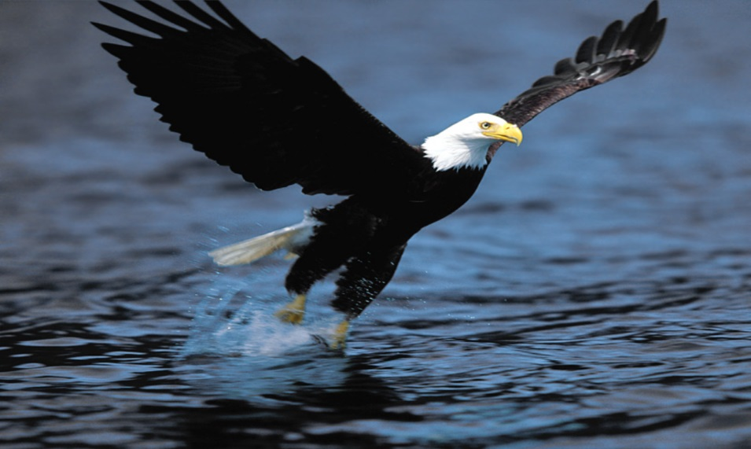
What is the most popular animal of Australia?
B.
eagle
A.
penguin
C.
koala

Slide 27
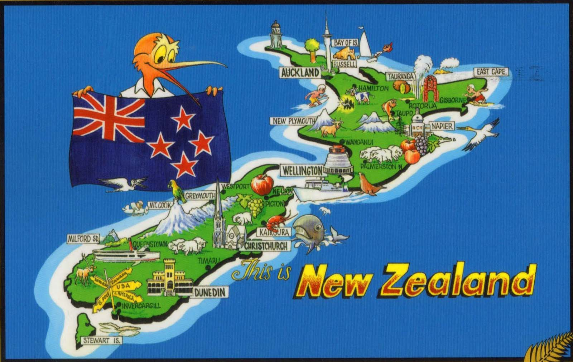
New Zealand

Slide 28
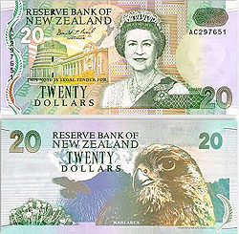
What is the monetary unit of New Zealand?
A. New Zealand pound
B. New Zealand shilling
C. New Zealand dollar

Slide 29


