Slide 1
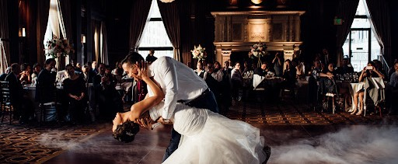
Wedding Dance Classes
https://adelaideweddingdance.com.au/group-dance-classes/

Slide 2
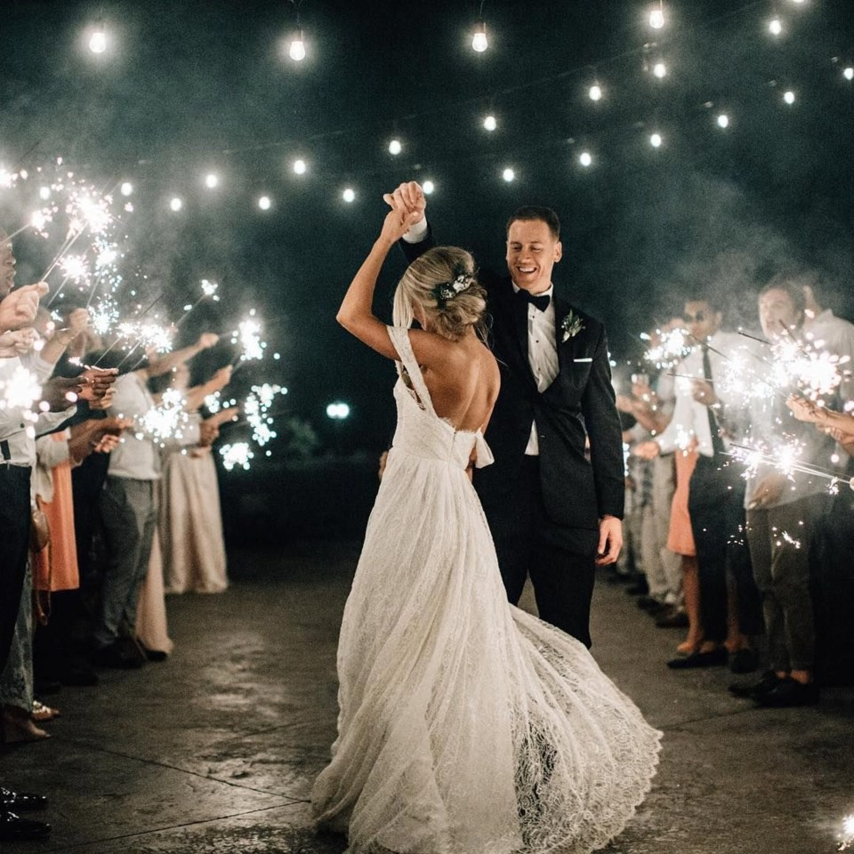


How about come in and try out any of our Group dance classes that
we have running 6 days a week. With up to 12 dance styles and 17 group dance classes that we teach each week – there will be something that you will fall in love with.

Slide 3
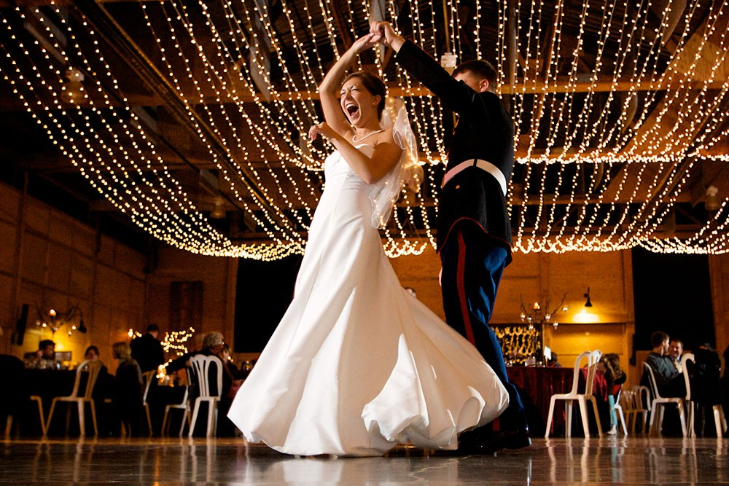
If you would like to learn the dance styles that is
traditional to wedding dances and is fast to pick up, come to our Elegant Waltz & Romantic Rumba group classes.
You will not go wrong with learning to dance with the grace and poise of “Kings & Queens” in our Elegant Waltz group dance classes

Slide 4
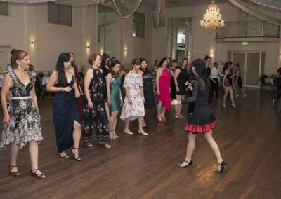
Salsa Group Dance Class
Come to our Caliente group dance classes (Spanish for
“Hot). In Caliente, Salsa Caliente & Bachata Caliente group dance classes, you will not only learn how the step patterns of the dance style, but you will shown how to spice up the dance with “hotter” grooves and body movements.

Slide 5

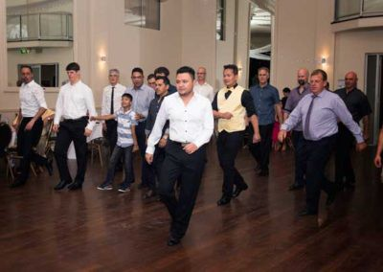
Caliente Group Dance Class
Guest participating in Caliente Group Dance Class

Slide 6
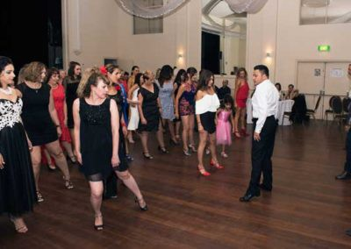
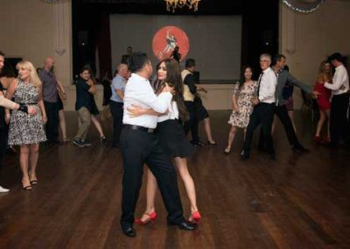
Caliente Group Dance Class
Caliente-Group-Dance-Class
Caliente Group Dance Class at Dance Amor Annual 8th Birthday Gala BAll
Guest participating in Caliente Group Dance Class

Slide 7

CONTACT
https://adelaideweddingdance.com.au/group-dance-classes/
Phone: (08) 8223 7848 or 0423 593 022
Email: be-unique@adelaideweddingdance.com.au

Slide 8

THANK YOU
https://adelaideweddingdance.com.au/group-dance-classes/

