Slide 1
Technium Regional Centers
Managers Training
https://techniumscience.com/

Slide 2
WELCOME TO TECHNIUM SCIENCE
Publisher of Open Access Journals & Books designed to make it easy for worldwide researchers to discover leading-edge scientific research. Working closely with the global scientific community has been at the heart of our book and journal publishing activity.
With a portfolio including journals, books, conference proceedings, we focus on engineering, physics, materials science, social sciences, management, environmental sciences and education. Technium Science also publishes on behalf of other scientific organizations and represents their needs and those of their members.
With worldwide impact, we support researchers, librarians and societies in their endeavours.

Slide 3
Submitting papers to Technium
For BioChemMed, please submit here: https://techniumscience.com/index.php/biochemmed/submissions
For Applied Sciences and Technology, please submit here: https://techniumscience.com/index.php/technium/about/submissions
For Social Sciences, please submit here: https://techniumscience.com/index.php/socialsciences/about/submissions
For Technium Books, please submit here: https://techniumscience.com/index.php/books/about/submissions
For Technium Conferences, please submit here: https://techniumscience.com/index.php/conference/about/submissions

Slide 4
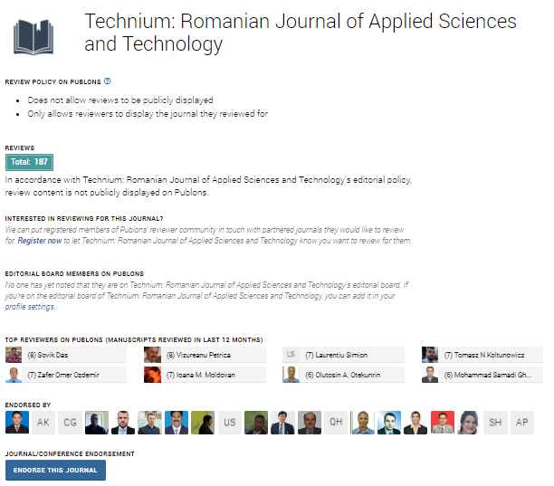
Join as reviewer with Clarivate Publons recognition
Register as reviewer here:
https://techniumscience.com/index.php/index/user/register
Once reviews completed we will send you email for Clarivate PUBLONS recognition

Slide 5

Email instructions:
Submissions
Forward to email: office@techniumscience.com
Databases
Complaints
Simply forward all requests to Technium Science editors
Email: office@techniumscience.com

Slide 6
“delivering visibility, impact, recognition and value to the scientific community”
©Technium Science

