Slide 1
The Prestige City
Mixed Township on Sarjapur main Road

Slide 2
Prestige Group is one of the renowned names in the real estate domain. It is known for conceptualising and delivering stellar residential and commercial projects. It has many upcoming projects lined up in Bangalore. The Prestige City pre-launch is one of the most superior product to be launched by Prestige.
The Prestige City Smart expansive residential project with a varied mix of residences will have a launch date in the second quarter of 2021

Slide 3
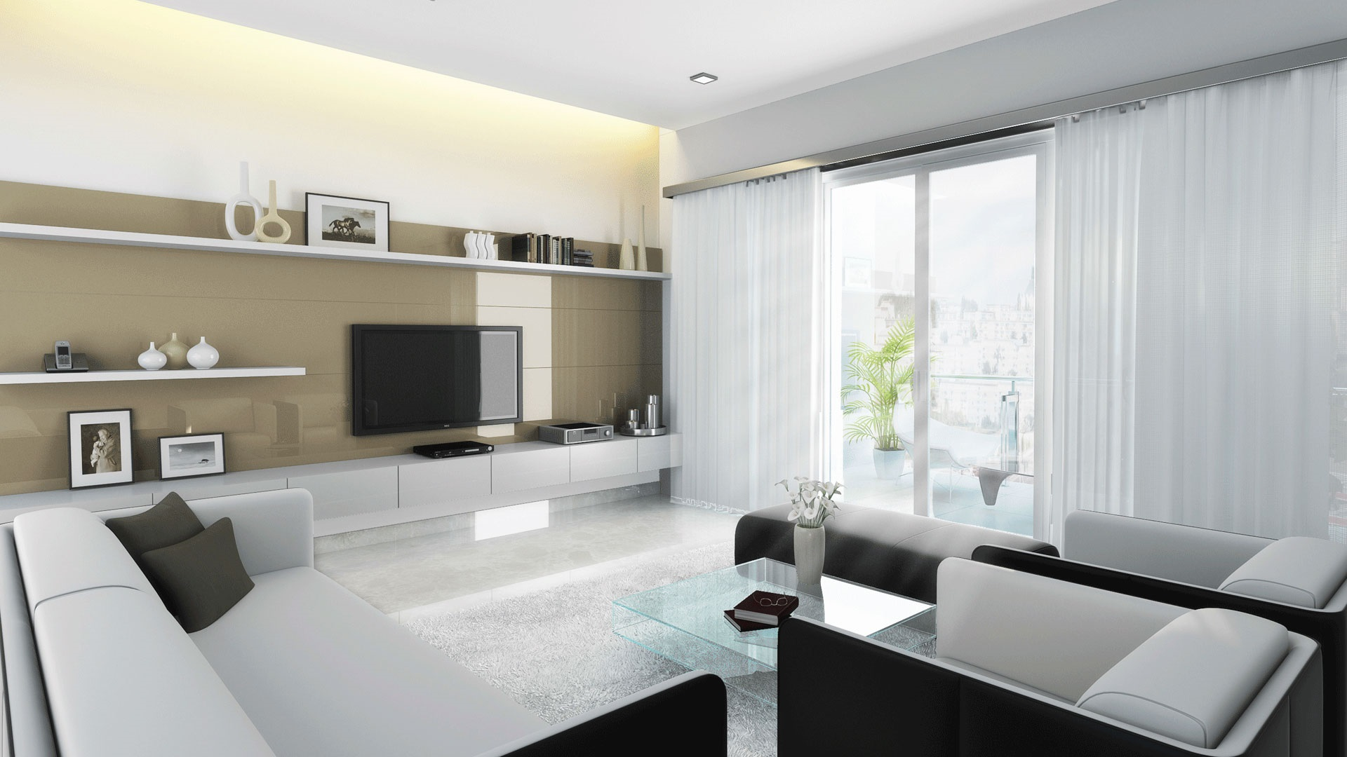
The Experiment
Real estate giant Prestige Group presents an elegant and modern housing complex. Spread over 180 acres, The Prestige City will house new flats of varied sizes. 1, 2, 3 and 4 bedroom set configurations spread on multiple towers, G+1 private villas and plotted estates.New projects in Bangalore have to get approval from Real Estate Regulatory Authority Karnataka. RERA of The Prestige City is yet to be approved by competent authorities Prestige Sarjapur road has perfectly shaped landscaping with open lush green spaces

Slide 4
Landmarks
Apollo Health Care
Double tree Suits
Delhi Public School
Market Square Mall
Found around the house!

Slide 5

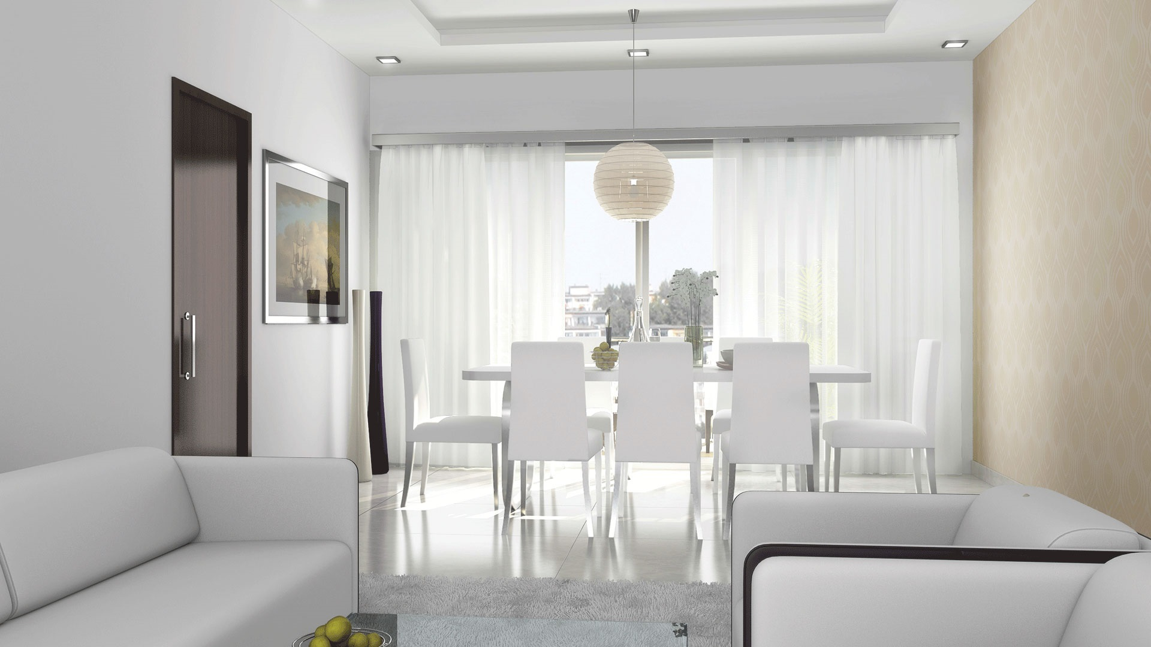
Interior of Prestige city

Slide 6
Sarjapur Lake – Adjacent to the project site in the South direction for which a buffer of 30m has been provided as per the Anekal Zonal Regulations.
Yamare Lake – 65m from the project site in the West direction.
Somapura Village – 600m from the project site in the South Direction

Slide 7
Talk To Us :
theprestigecity3@gmail.com
Our site link : https://www.prestigecity.gen.in/contact.html

