Slide 1

Who is the smartest?

Slide 2

II. Grammar Practice

Slide 3

1. Why ... birds fly south in the winter? - It's too far to walk.
a) does b) many c) do d) have e) has
2. John went to a party:
a) tonight b) yesterday c) next week d) soon e) tomorrow
3. Good is to better as bad is to ... .
a) worst b) badder c) worse d) the worse e) the worst
4. - I'd like some coffee. - I'm afraid there isn't ... .
a) more b) anything c) none d) any e) some
5. What did you do yesterday?
a) I was studying. b) I studied. c) I study. d) I'm studying. e) I'll study.
6. I think football is more interesting ... basketball.
a) the b) over c) than d) then e) even
7. How can we say "18.35" in other words?
a) 25 to seven b) 35 to six c) a quarter to seven d) 25 to nine e) five minutes past half past
8. My father is sitting ... the chair.
a) in b) under c) on d) at e) behind
9. Ann didn't ... her teeth in the morning.
a) brush b) brushed c) brushing d) is brushing e) brushes
10. She … to the cinema every week.
a) not to go b) don’t go c) doesn’t go d) isn’t go

Slide 4

III (a). Tricky Questions

Slide 5
1. The eighth month of the year is:
a) September
b) November
c) December
d) October
e) August

Slide 6
2. What is held on April 1st?
a) April's Day
b) Spring Festival
c) April Fool's Day
d) Children's Day
e) Flower Festival

Slide 7
3. Julie has two brothers, one sister, two aunts, and three uncles. How many children does Julie's mother have?
a) 2
b) 3
c) 4
d) 5
e) 6

Slide 8
4. How many months have 28 days?
a) one
b) all of them
c) some of them
d) six
e) eight

Slide 9
5. "Two brothers but they don't see each other".
a) eyes
b) legs
c) hands
d) teeth
e) a clock

Slide 10
6. Today is December 9th. It's Thursday. Sally's birthday is on December 13th. Which day of the week is it this year?
a) Sunday
b) Monday
c) Tuesday
d) Saturday
e) Wednesday

Slide 11

III (b). Rhymes

Slide 12
Write rhymes to the words.
Cat – Book –
Tree – Fish –
Plate – House –
Feet – Pen –
Car – Floor –
Foot – Light –
Box – Day –

Slide 13
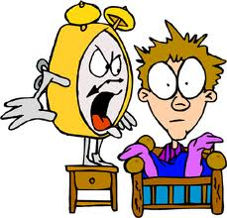
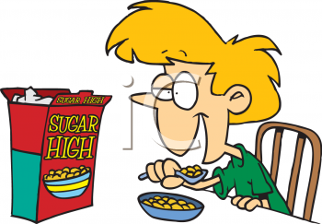
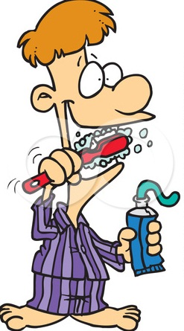
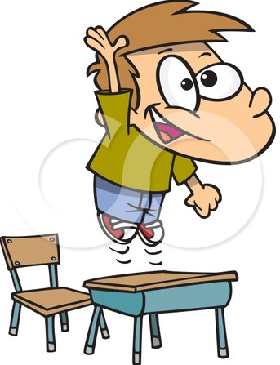
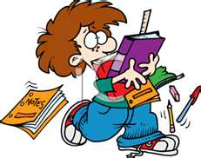
IV. My Day
Make up 10 sentences about your day.

Slide 14
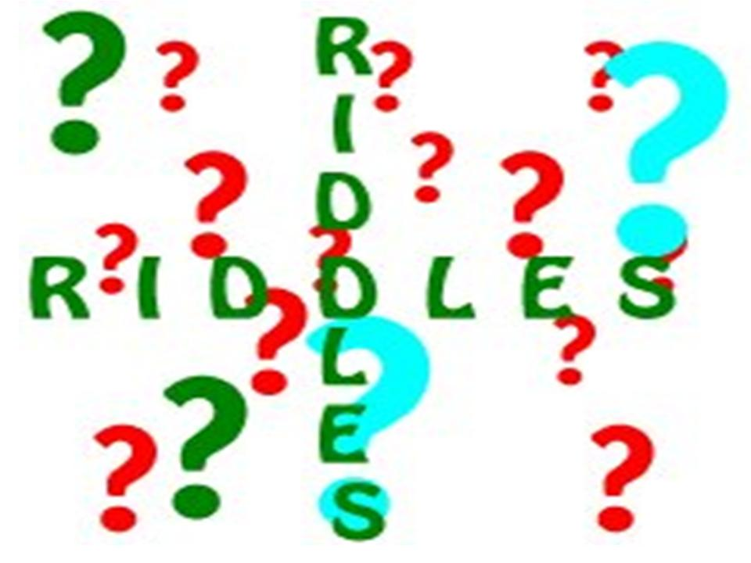
V. Riddles

Slide 15
It runs but has no legs.
What man can’t live inside the house?
Which letter of the alphabet has the most water?
What starts with a ‘P’, ends with an ‘E’ and has thousands of letters?
How many letters are there in the English alphabet?

Slide 16

Thank you for participation!

